Slide 1
Digital Asset Custody Service
: Project Requirements, High-level, Detailed design
Haechan Lee
Nguyen, Van Tu
Minji Choi
Jeongheon Kim

Slide 2
Project Overview
Digital Asset Custody Service (DACS)
Keep users private digital asset (Cryptocurrency, NFT) safely
Digital asset’s ownership can be proved by only the owner’s private key
Two kinds of DACS
Digital asset consignment management service
Private key management service
In this project
Implement digital asset consignment management service using Multi-party computation (MPC)
Implement private key management service using Multi-sig

Slide 3
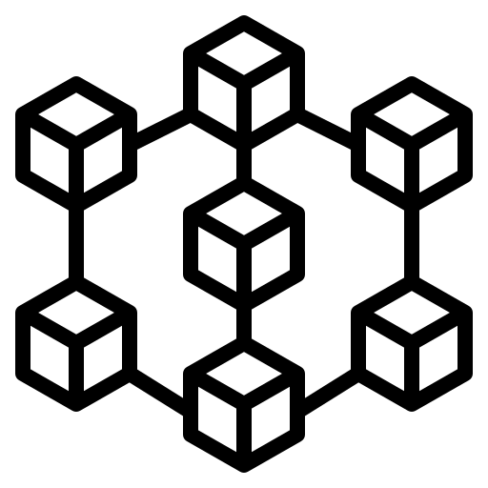
Architecture
Customer
Customer
Customer
Customer
Customer
User Wallet – Web (Front-End)
API
API
API
API
API
Multi-sig Smart Contract
Intermediary Server (Back-End)
User Backup Key Storage
Key Storage
Key Storage
Key Storage
Cold Wallet
Cold Wallet
Cold Wallet
Blockchain Node
Cold Wallet for Multi-sig
MPC-based Key Management System
MPC-based Key Management System
MPC-based Key Management System
Service Provider

Slide 4




High-level Workflow – Consignment management (Found asset)
1. Request to found the consigned asset
2. Send request using API
3. Request signature
4. Create signature using MPC
5. Send created signature
6. Send signed transaction
7. Confirm transaction
8. Check balance
Customer
Wallet
Server
Blockchain
Key Storage

Slide 5
High-level Workflow – Key management (Send transaction)
1. Request to send transaction using keys
2. Send request using API
2-a. Request backup key if one of user’s key is lost
3. Call the multi-sig smart contract
4. Confirm transaction
5. Check transaction history
Customer
Wallet
Server
Blockchain
Backup Key Storage

Slide 6
Functional aspect
Customer
Wallet (Front-end)
User Interface - Login, Cryptocurrency dashboard, Send transaction
Server (Back-end)
Wallet API for communicate with wallet
Blockchain client for connect to blockchain node
Communicate with key storage
Blockchain Node
Multi-signature smart contract
Private network for testing the function
Key Storage
Cold wallet – Save the share of private key
MPC-based key management system – Make the signature without exposing keys to each other
Backup key storage – Store one of private key to use multi-signature for key recovery

Slide 7
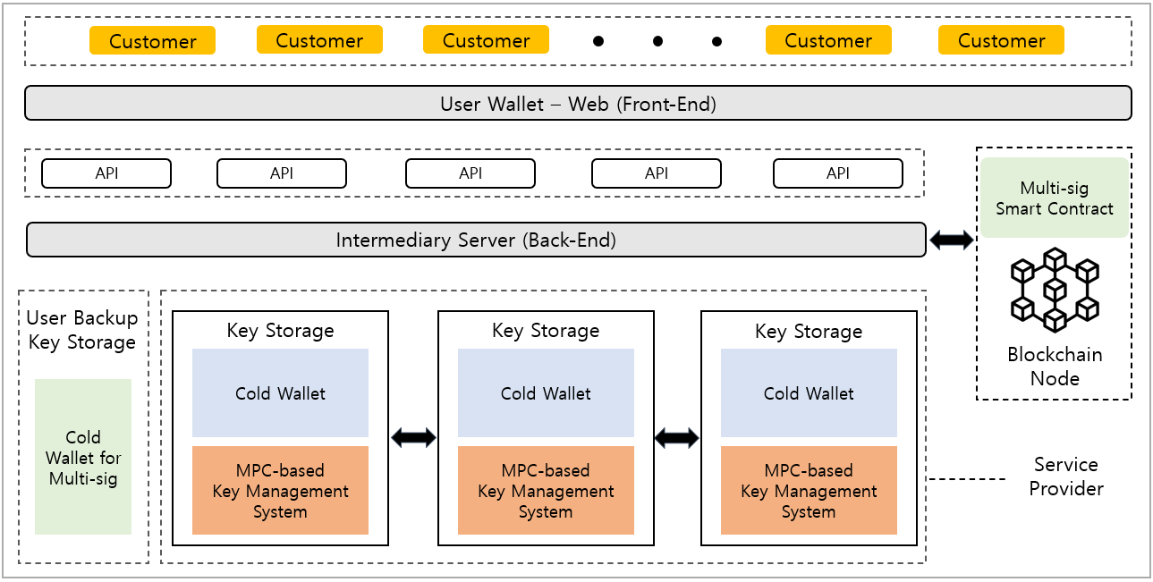



Implementation
User interface
2-of-3 multi-sig (Open Source) (https://github.com/BitGo/eth-multisig-v4)
Ethereum private network
Node.js for API server
Geth (Go-Ethereum) for Ethereum client
(https://github.com/ethereum/go-Ethereum)
Server
Multi-party ECDSA protocol (Open Source)
Lindell17 (2-party ECDSA)¹
GG18 (ECDSA Threshold)²
GG20 (One round ECDSA Threshold)³
[1] Lindell, Y.: Fast secure two-party ecdsa signing. In: Annual International Cryptology Conference. pp. 613–644. Springer (2017)
[2] Gennaro, R., Goldfeder, S.: Fast multiparty threshold ecdsa with fast trustless setup. In: Proceedings of the 2018 ACM SIGSAC Conference on Computer and Communications Security. pp. 1179–1194. ACM (2018)
[3] Gennaro, R., Goldfeder, S.: One round threshold ecdsa with identifiable abort. Cryptology ePrint Archive, Report 2020/540 (2020)

Slide 8
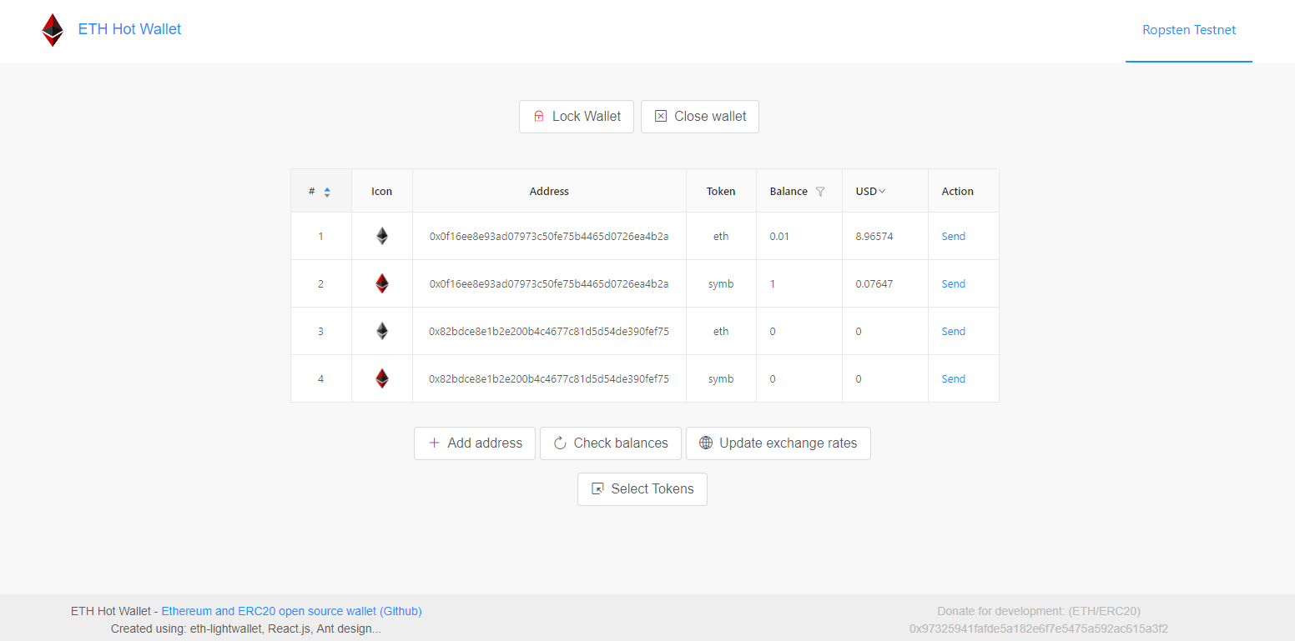
User wallet
User interface using React
Consist with Javascript
Needed function
Create account
Send transaction
Check balance
Check history of transaction
Ex) https://github.com/PaulLaux/eth-hot-wallet
Example of wallet

Slide 9
Server
Ethereum Javascript API
Use Web3.js
Connect with user wallet and send request to storage or blockchain node
https://github.com/ChainSafe/web3.js
Integrated Key Management System
Recover the user’s private key by request to the backup key storage
Request the service provider’s signature which is generated by MPC protocol

Slide 10
Blockchain
Blockchain Node
Ethereum Private network or Testnet (Select Ethereum to use ECDSA signing algorithm)
Use geth (go-Ethereum)
https://github.com/ethereum/go-ethereum
Multi-signature Smart Contract
2-of-3 multi-sig structure
User will get 2 private keys, and service provider will get 1 private keys
Deploy to Ethereum private network / Testnet
https://github.com/BitGo/eth-multisig-v4
Implemented as solidity

Slide 11
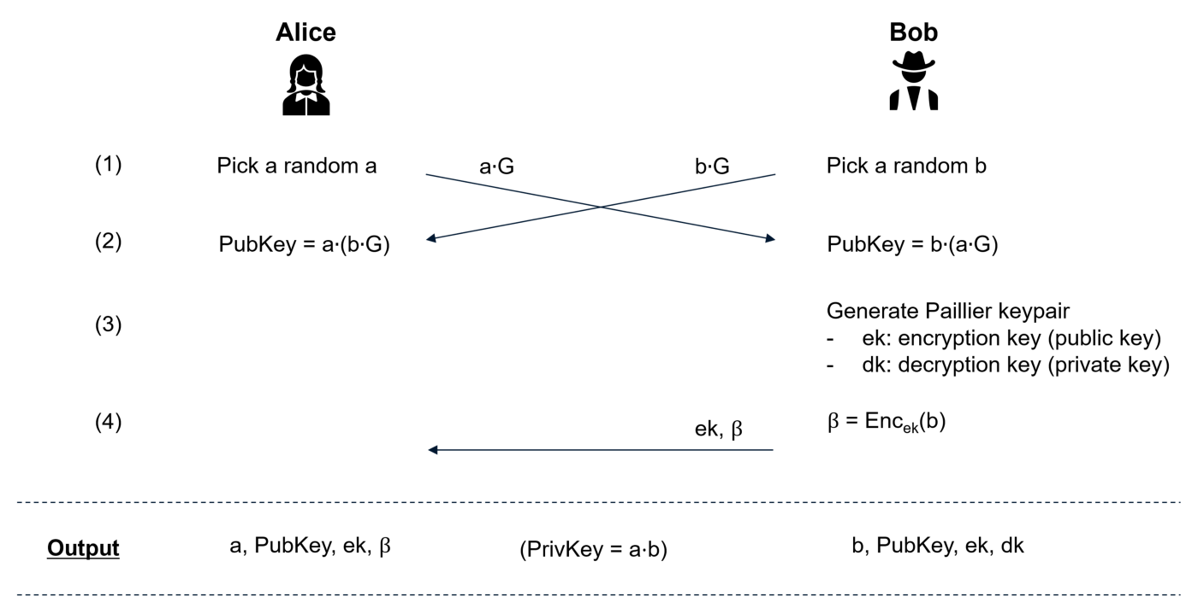
Detailed Protocol – MPC based key management system
Distributed Key Generation – 2 party ECDSA

Slide 12
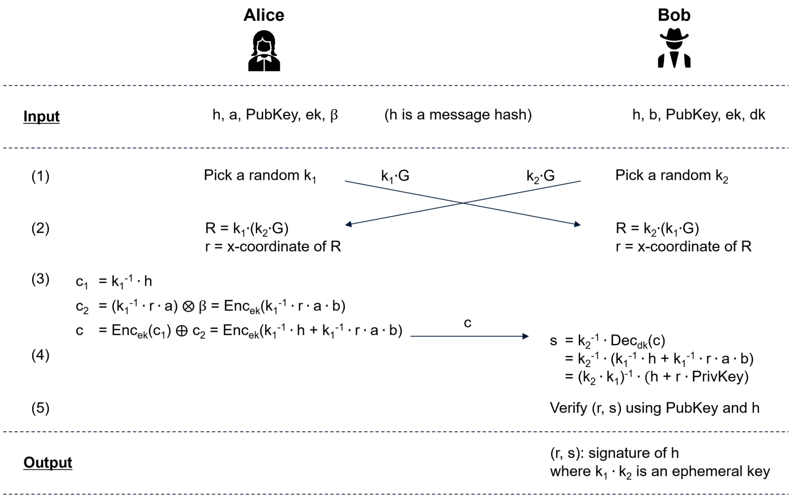
Detailed Protocol – MPC based key management system
Distributed signing – 2 party ECDSA

Slide 13
MPC based key management system
Lindell17
2 party ECDSA protocol
Fast, simple but Shamir secret sharing is not applied, so it can’t recover private key if lost
https://github.com/unboundsecurity/blockchain-crypto-mpc
Implemented as C/C++
GG18
ECDSA Threshold Signature Scheme
Unlike above, it applies N-of-T(threshold+1) scheme to create signature (Shamir secret sharing applied)
https://github.com/ZenGo-X/multi-party-ecdsa (also GG20 is implemented)
Implemented as Rust
GG20
One round Threshold ECDSA
Improve version of GG18 by create signature only one round (GG18 needs T rounds)
https://github.com/coinbase/kryptology/tree/master/pkg/dkg/gennaro
Implemented as Go

Slide 14
Finish

